Slide 1

STUDENT NAME: KEERTHI VASAN
REGISTER NO AND NMID:212400948 80E7377D6B800BEB6C7496DD3A34F52C
DEPARTMENT: BCA
COLLEGE/UNIVERSITY:PRINCE SHRI VENKATESHWARA ARTS AND SCIENCE COLLEGE

Slide 2
DIGITAL PORTFOLIO
PROJECT TITLE:
-BY KEERTHIVASAN P

Slide 3

AGENDA
• Problem statement
• Project overview
• End users
• Tools and technologies
• Portfolio design and layout
• Features and functionality
• Result and screenshots
• Conclsion

Slide 4
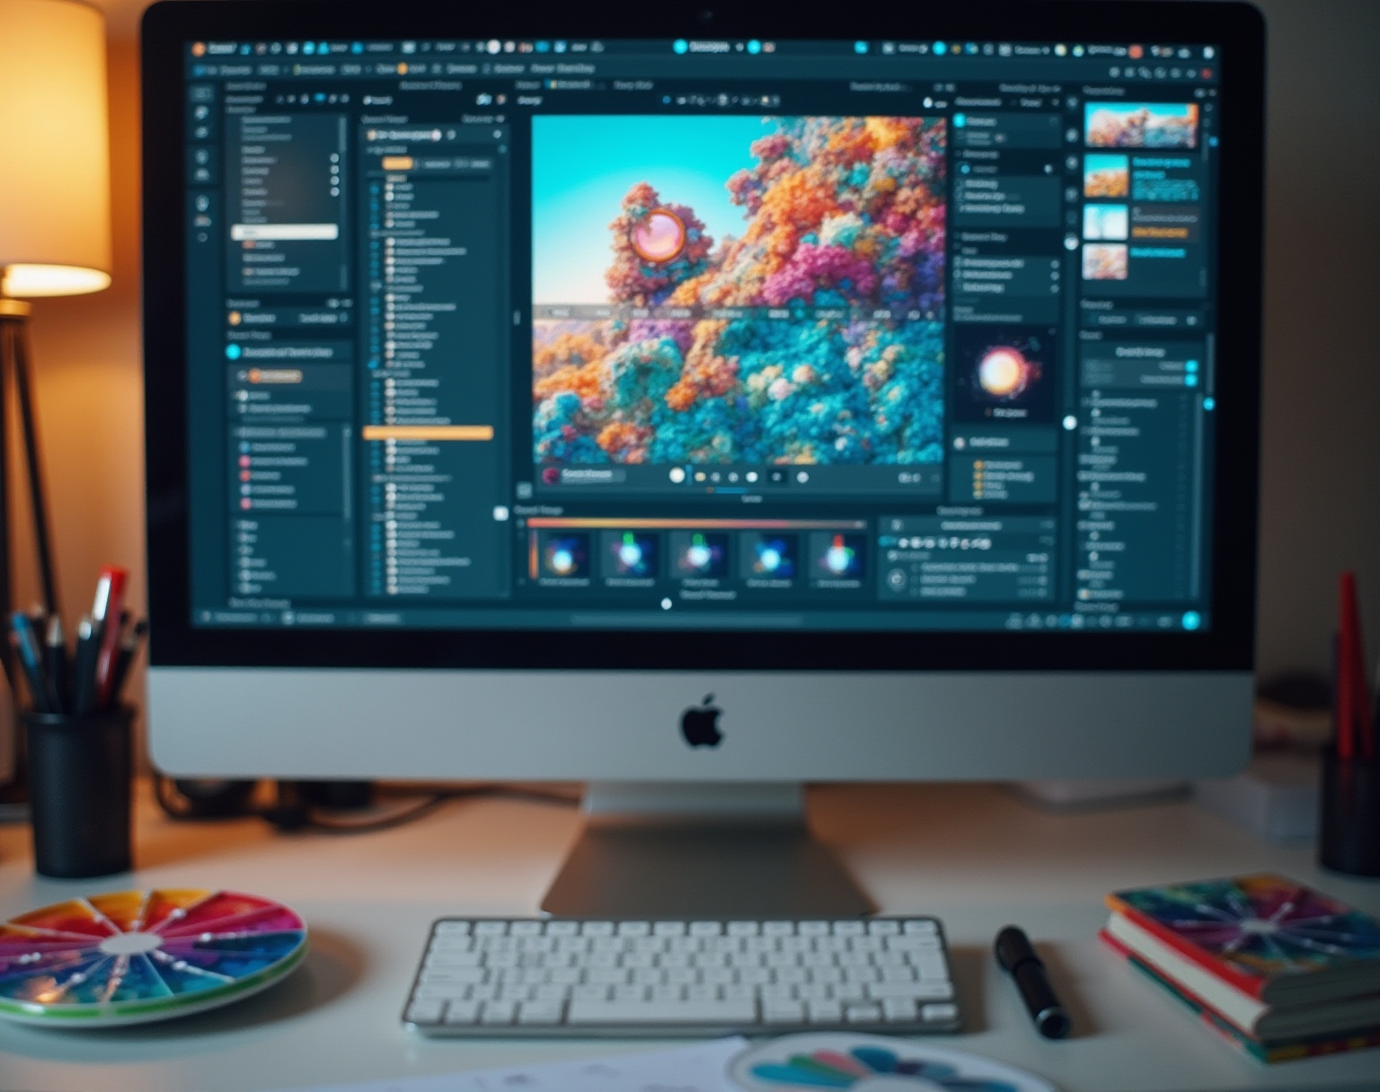
Problem Statement:
Many students lack a personal digital space to showcase their skills.
Traditional resumes do not effectively demonstrate projects and coding abilities.
A portfolio website provides a professional and accessible way to highlight skills, projects, and achievements.

Slide 5
Project Overview:
Created a personal portfolio website.
Highlights academic background, skills, and projects.
Provides contact details and GitHub profile link.
Built using HTML, CSS, and JavaScript.

Slide 6

End Users:
Students: To showcase projects and skills.
Recruiters / Employers: To evaluate candidate portfolios.
Peers and Educators: For collaboration and feedback.

Slide 7
Tools and Technique:
HTML5 - Structure of the website.
CSS3 - Styling and responsive design.
JavaScript - Interactive elements.
CodePen - For development and live preview.

Slide 8

Portfolio design and layout :
Clean and modern Ul with a dark theme.
Sections included:
About Me
Skills
Projects
Contact
Responsive design for mobile and desktop view.

Slide 9
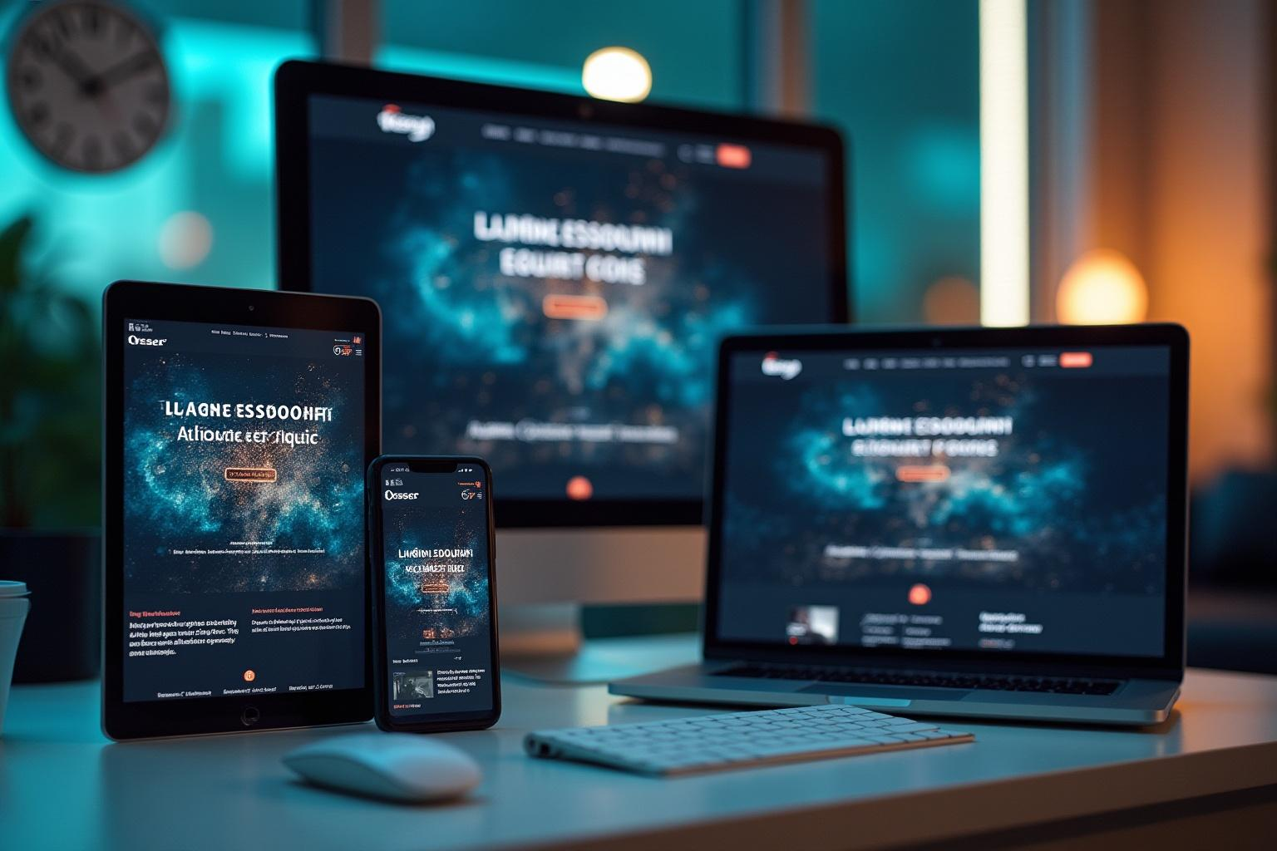
Features and Functionalities:
Showcases personal introduction and academic details.
Skill progress bar for visual representation.
Project section with description.
Contact details with college email and GitHub link.
Footer with copyright.

Slide 10
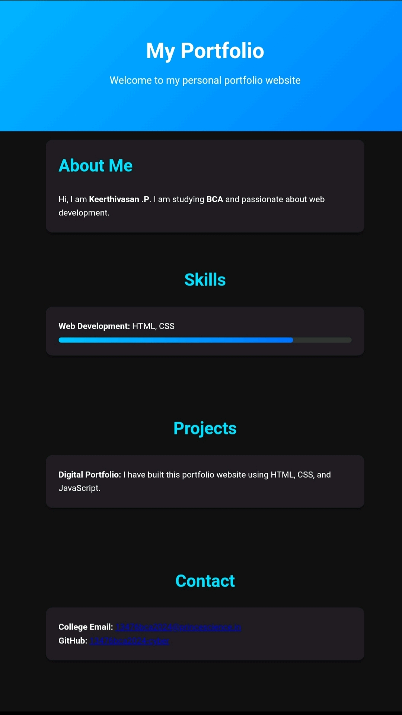
Result and screenshots :

Slide 11

Conclusions:
A digital portfolio is essential in today's job market.
Helps students and professionals stand out.
This project enhanced my skills in front-end development.
Future improvements: Add more interactivity and projects.

Slide 12
GitHub:
https://13476bca2024-cyber.github.io/My-portfolio/

